Slide 1
HR Analytics on Employee Retention and Attrition
J. Tuason, J. Flores, A. Gamboa

Slide 2
01.
Introduction
02.
Employee Evaluations
03.
Clustering using K-Prototypes
04.
Key Driver Identification
Table of contents
05.
Classification Model: Decision Tree
06.
Insights and Recommendation

Slide 3

Introduction
Business Intelligence and Analytics
HR Analytics
People analytics is the deeply data driven and goal focused method of studying all people processes, functions, challenges, and opportunities at work to elevate these systems and achieve sustainable business success.
-Parathana Gosh (“What is People Analytics? Definiton, Process, Trends, and Tools)

Slide 4

Employee Evaluations
14,999 Employees
3,571 Resigned (24% Attrition)

Slide 5
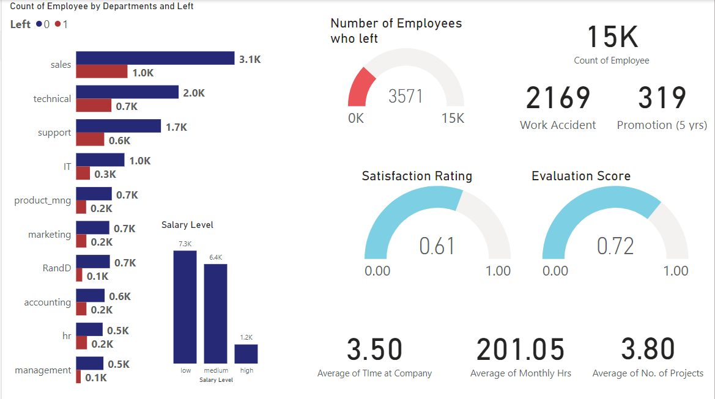
Descriptive Statistics

Slide 6
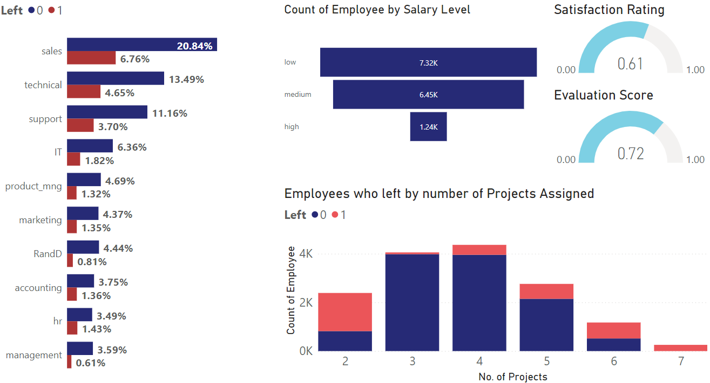
Number of Projects

Slide 7

Clustering Using K-Prototypes
Cluster 0
Cluster 1
Cluster 3
Disenchanted, High Performer Overworked. Many Left
Content Slackers
Average sastisfaction, fewer projects. Can yet be engaged
Cluster 4
The Sweet Spot Achievers happy to work the hours needed for multiple projects
The Average Employee
Puts in the required work, unlikely to leave
Cluster 2
The Disengaged
Low Performers, fewer projects. Likely to leave

Slide 8
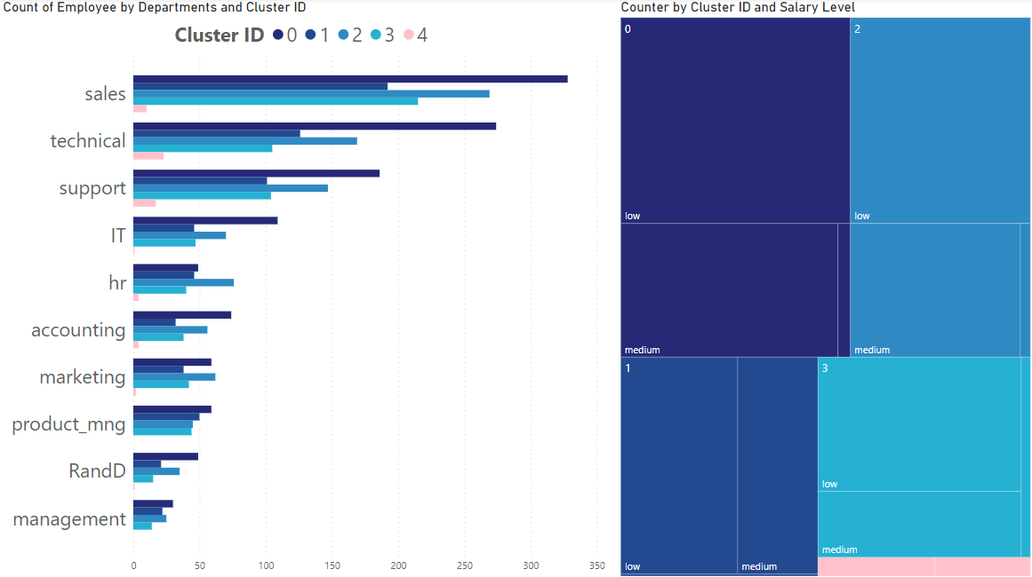
Clusters

Slide 9
Clusters

Slide 10
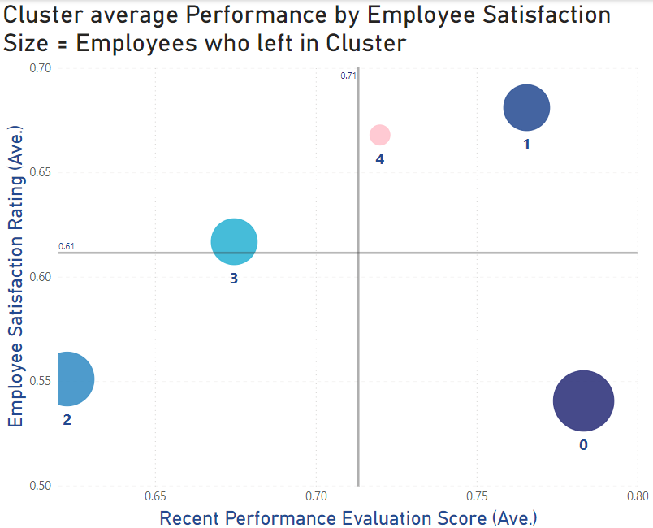
Clusters - Performance
Average employees
The Sweet spot
Content slacker
The Disenchanted
The disengaged
10

Slide 11
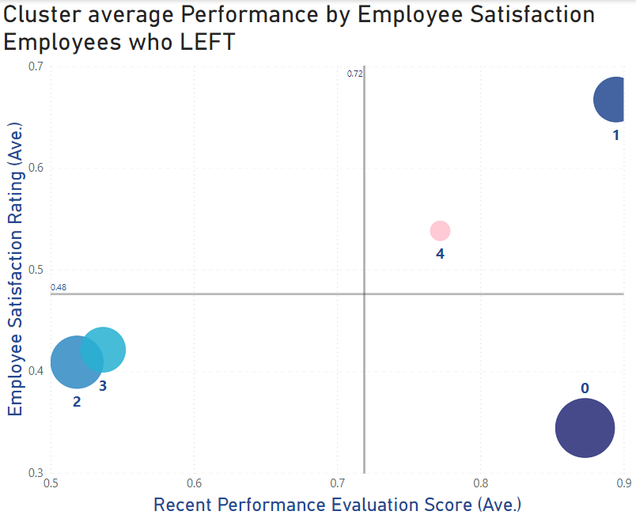
Clusters
The Sweet spot
Average employees
Content slacker
The Disenchanted
The disengaged
11

Slide 12
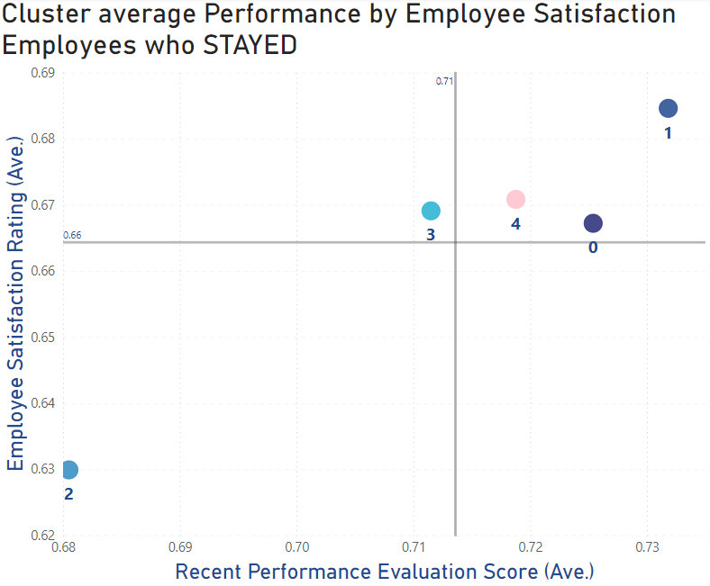
Clusters – Employee Satisfaction
The Sweet spot
Average employees
Content slacker
The Disenchanted
The disengaged
12

Slide 13
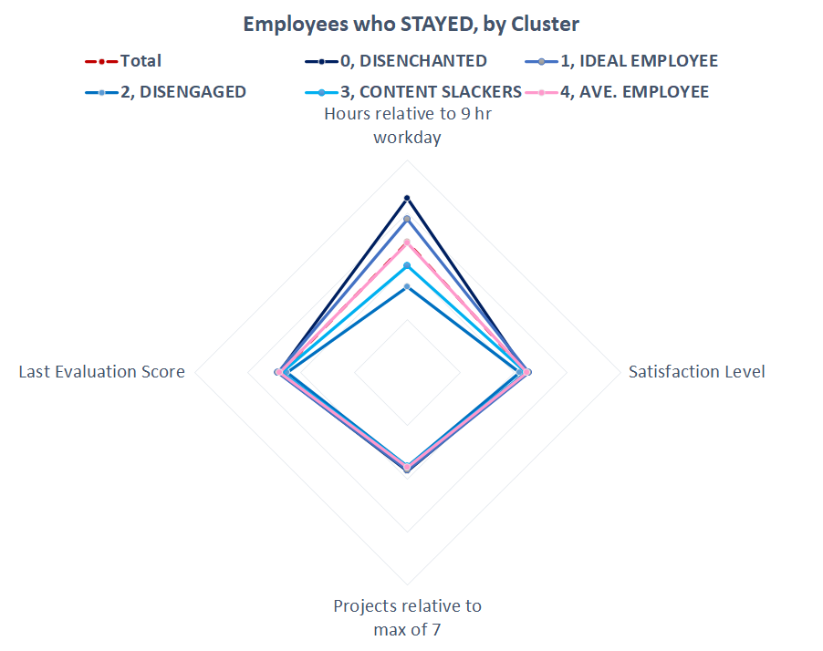
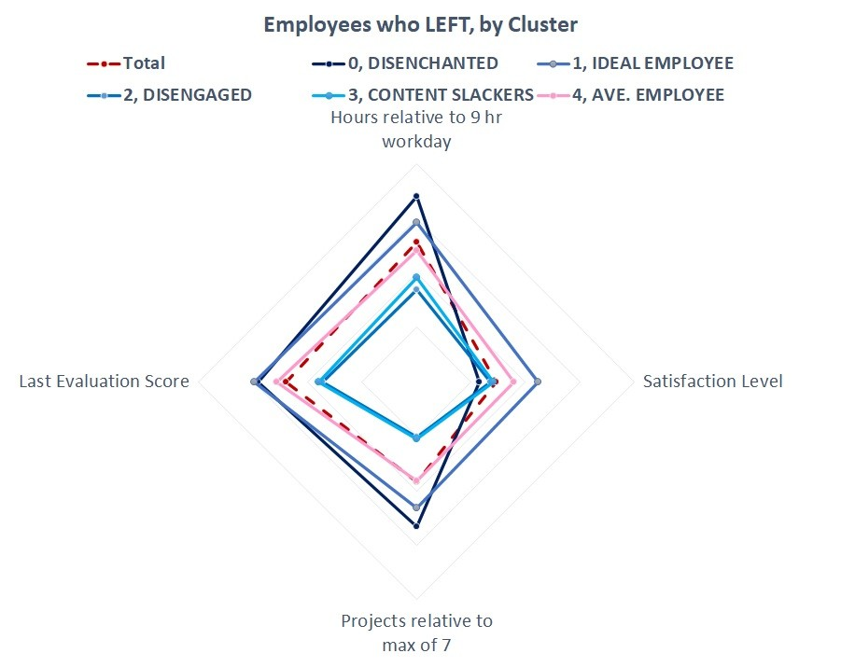
Clusters
13

Slide 14
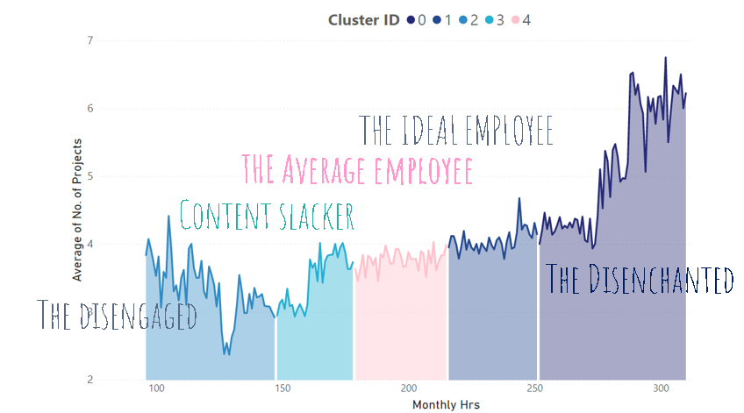
Clusters –Monthly hours by Number of Projects
14

Slide 15
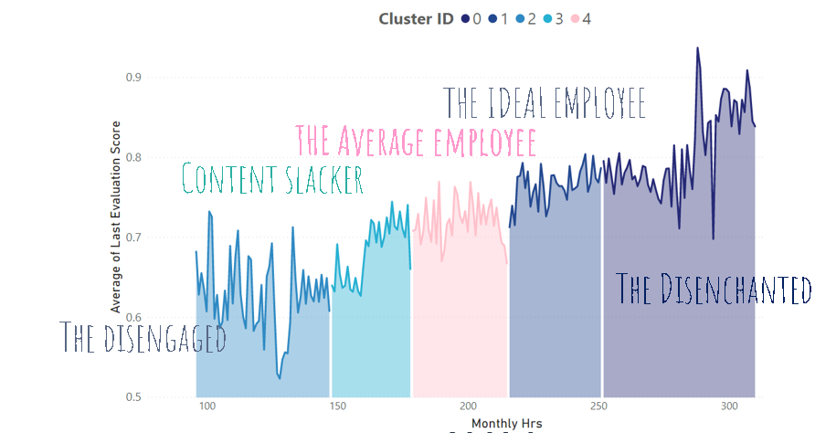
Clusters –Monthly hours by Average of Last Eval Score
15

Slide 16
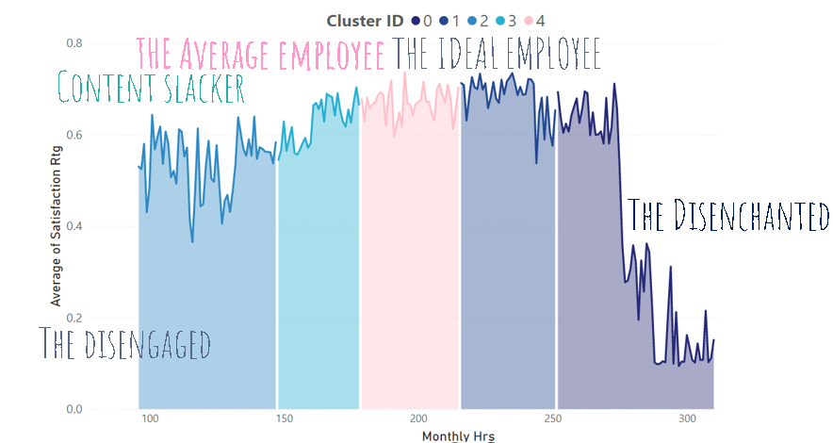
Clusters –Monthly hours by Satisfaction Rating
16

Slide 17

Recommendations
More info about our employees: sex, number of children
Do not give more 7 projects. Up to 5 is okay (in terms of satisfaction) for some clusters.
Address the Disenchanted’s concerns, study and monitor the Ideal and Average employees.

Slide 18
Key Driver identification
Business Intelligence and Analytics
People Analytics
(Feature Scre, Feature Importance, SHAP Values)

Slide 19
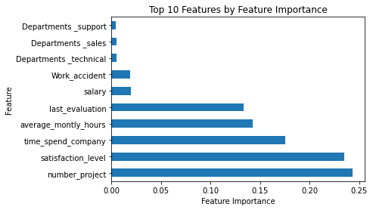
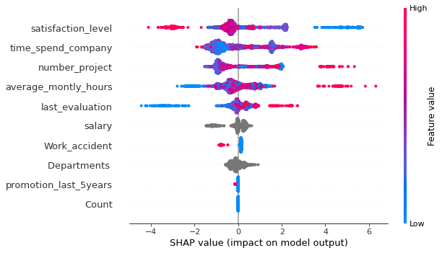
Feature Importance and SHAP Values
Top 5 Key Features are:
Satisfaction Level, Last Evaluation, average monthly hours, time spend company, satisfaction level, number of projects

Slide 20
Decision Tree Classifier
Business Intelligence and Analytics
HR Analytics
The decision tree classifier (Pang-Ning et al., 2006) creates the classification model by building a decision tree. Each node in the tree specifies a test on an attribute, each branch descending from that node corresponds to one of the possible values for that attribute.

Slide 21

The human experience
10th grade
Caveat – Decision Tree
Overfitting – can be reduced by:
Feature Selection
Pruning (Lowering the Maximum Depth)

Slide 22
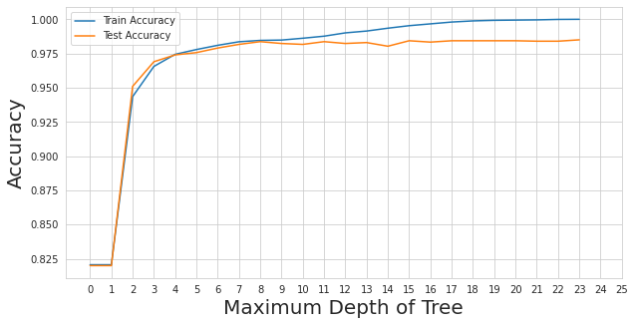
Decision Tree: Learning Curve
Max-depth = 4

Slide 23
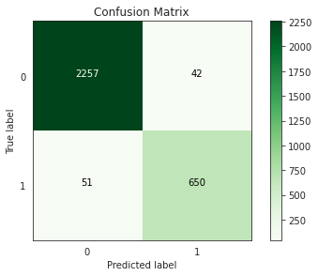
Decision Tree: Confusion Matrix and Accuracy
Metrics:
Accuracy: 97.7%
Recall: 92.6%
F1 Score: 95.2%

Slide 24
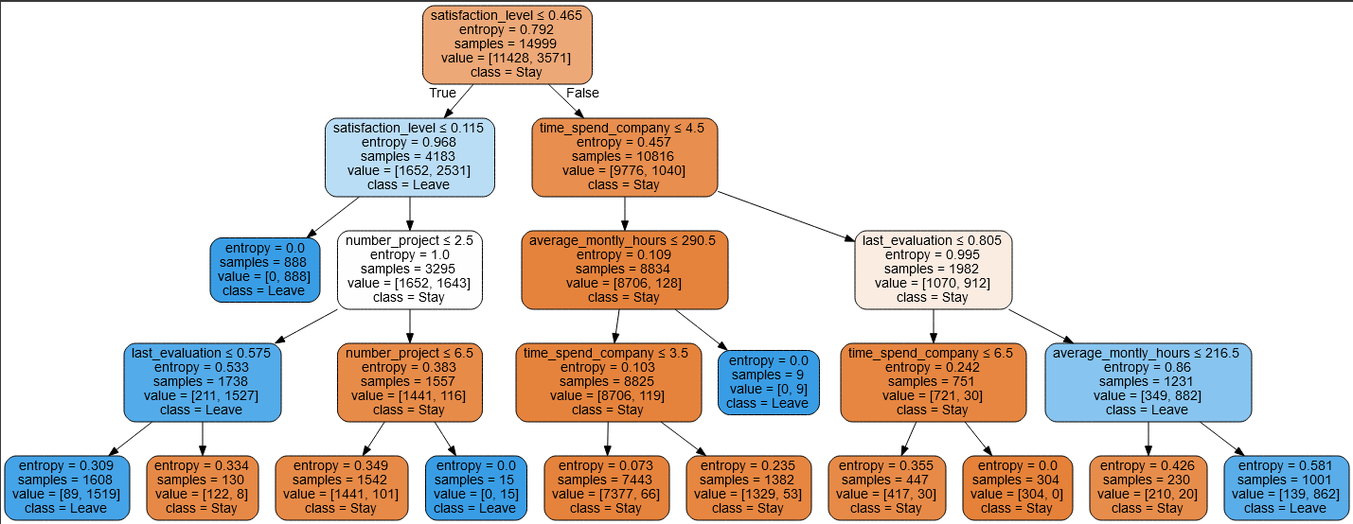
Decision Tree with Max Depth of 4

Slide 25
Decision Tree : Employees who Left (Entropy = 0)
Satisfaction Level less than 11.5%

Slide 26
Decision Tree : Employees who left (Entropy = 0.309)
Satisfaction level between 11.5% to 46.5%, less than 2 projects, and less than 57% in the last evaluation

Slide 27
Decision Tree : Employees who left (Entropy = 0)
Satisfaction level between 11.5% to 46.5%, projects assigned more than 7

Slide 28
Decision Tree : Employees who left (Entropy = 0)
Satisfaction level between 11.5% to 46.5%, greater than 5 years in the company, and spends more than 290

Slide 29
Decision Tree : Employees who left (Entropy = 0.581)
Satisfaction level greater than 46.5%, greater than 80% in last evaluation , and less than 216 hours monthly

Slide 30
Key Insights
 | Content | Interpretation
Type 0 | Satisfaction Level less that 11.5% | Very Unsatisfied
Type 1 | Satisfaction level between 11.5% to 46.5%, less than 2 projects, and less than 57% in the last evaluation | Unsatisfied, low performance, underwhelmed
Type 2 | Satisfaction level between 11.5% to 46.5%, projects more than 7 | Unsatisfied, overwhelmed
Type 3 | Satisfaction level between 11.5% to 46.5%, less than 4 years in the company, and spends more than 290 hours monthly | Unsatisfied , Overworked/Burned out Employees
Type 4 | Satisfaction level greater than 46.5%, greater than 80% in last evaluation , less than 5 years in the company, and works more than 216 hours monthly | Satisfied, high performers

Slide 31
 | Employee | Recommendation
Type 0 | Very Unsatisfied | Investigate further the cause of dissatisfaction
Type 1 | Unsatisfied, low performance, underwhelmed | Add more projects, but not too many projects, and observe performance
Type 2 | Unsatisfied overwhelmed | Reduce the number of Projects assigned to the employee
Type 3 | Unsatisfied , Overworked/Burned out Employees | Implement a work-life-balance program , employee engagement activities
Type 4 | Satisfied, high performing employees | Look further at gender , maybe family related resignation, Salary Counteroffer

Slide 32
“The people who stayed through are the people who were either great at it or the people who just didn’t know how to stop.”
Business Intelligence and Analytics
People Analytics
Michael Arad Israeli-American architect, WTC Memorial Designer

Slide 33



Our team
Joey Tuason
Jam Flores
Alexis Gamboa

Slide 34
Thanks!
Business Intelligence and Analytics
People Analytics

